Slide 1

Business Analyst, Product Operations Assignment
Driver’s LTV Analysis

Slide 2
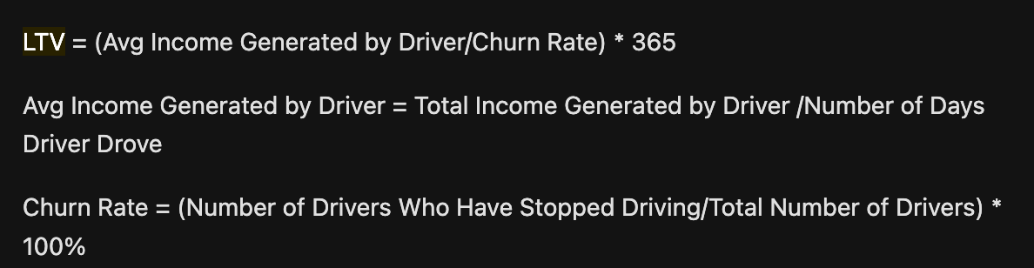
LTV
Value of a driver to Lyft over the entire projected lifetime of a driver
Equation:
Assumptions:
3 months of data is good enough to determine LTV, which usually is not the case. More data, the more precise LTV will be and informative to business strategy.

Slide 3
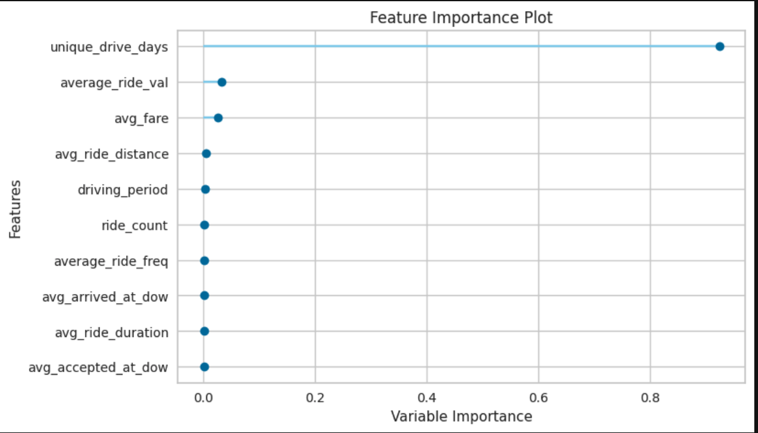
Main Factors Affecting LTV
We can see in this chart that number of different days driver has driven for has the most impact on LTV.
Some other factors include ride cost, usual fare for each driver’s ride, how long in distance each ride is, how long in duration each ride is. With the following slides, you will see degree in which each behavior is linked to LTV.

Slide 4
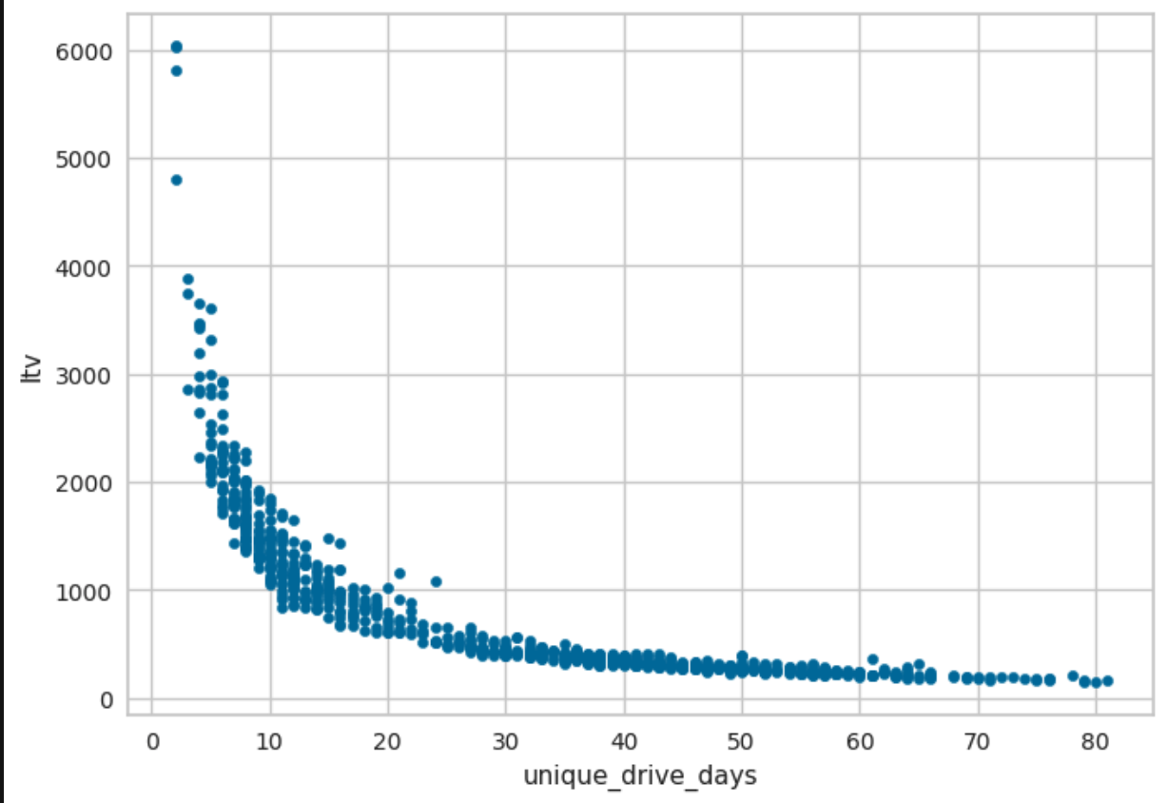
Number of Unique Driving Days
Most interesting finding is that those who provide most value to Lyft drive the least number of days, which means whenever they’re out completing rides, they have a high volume of rides they are completing!

Slide 5
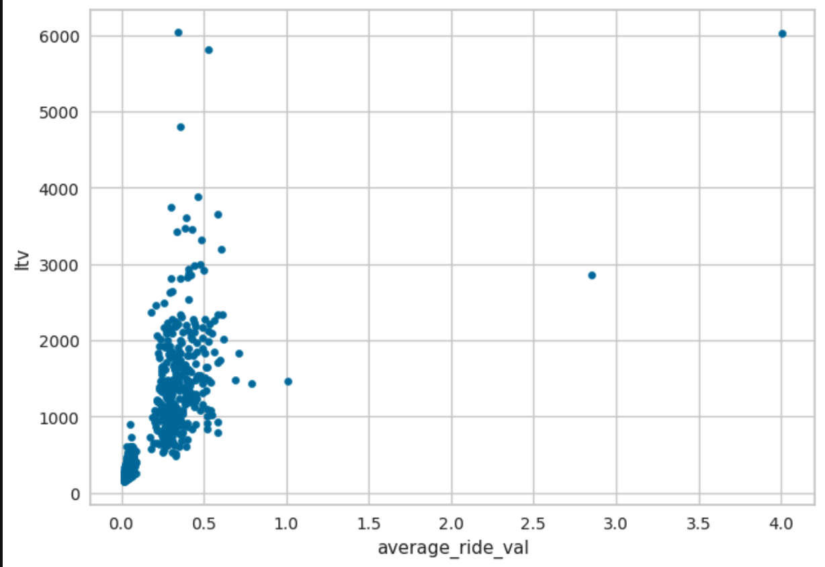
Average Ride Value
Even the average ride value ($) does not have a strong correlation to LTV as would be suspected would be a strong indicator for high LTV.

Slide 6
Average Projected Lifetime of Driver
This was determined by our churn rate
Churn rate was determined by churn definition, which was driver who had no activity within 7 days from last recorded ride
With churn rate determined, lifetime of driver defined as inverse of churn rate

Slide 7
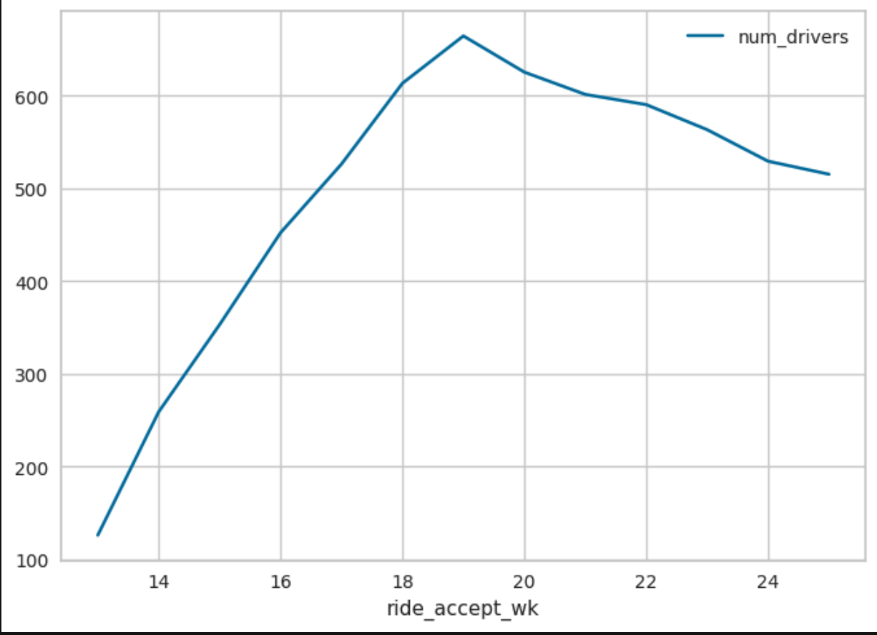
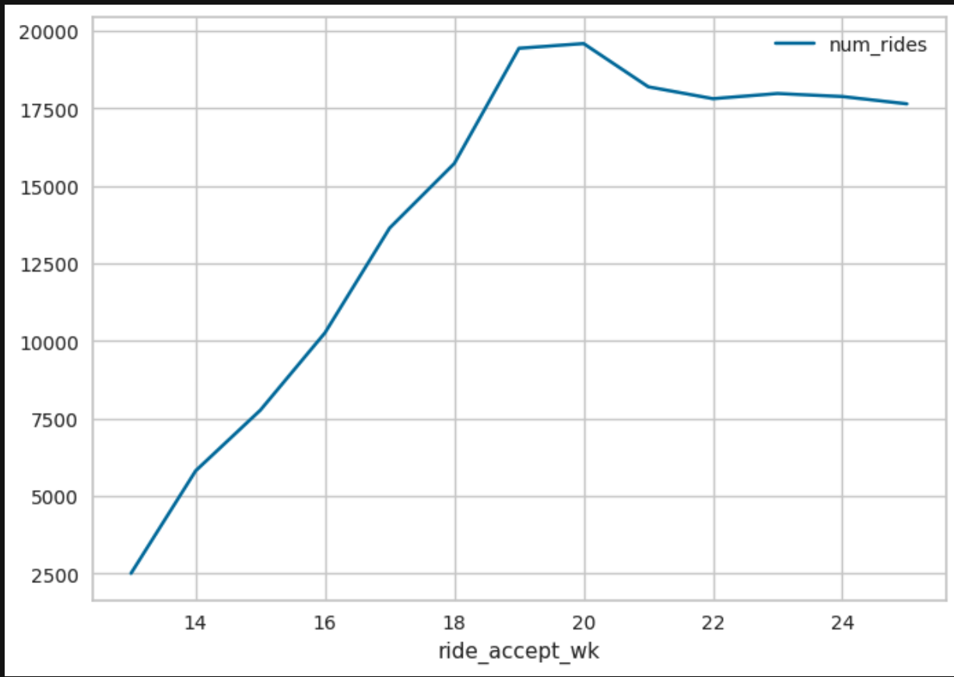
Number Rides and Active Drivers By Week
We can see here that number of rides trends with number of drivers. When number of drivers peaks, so does number of rides. Peak most likely due to promotion or maybe some special event. Marketing would be good place to ask.

Slide 8
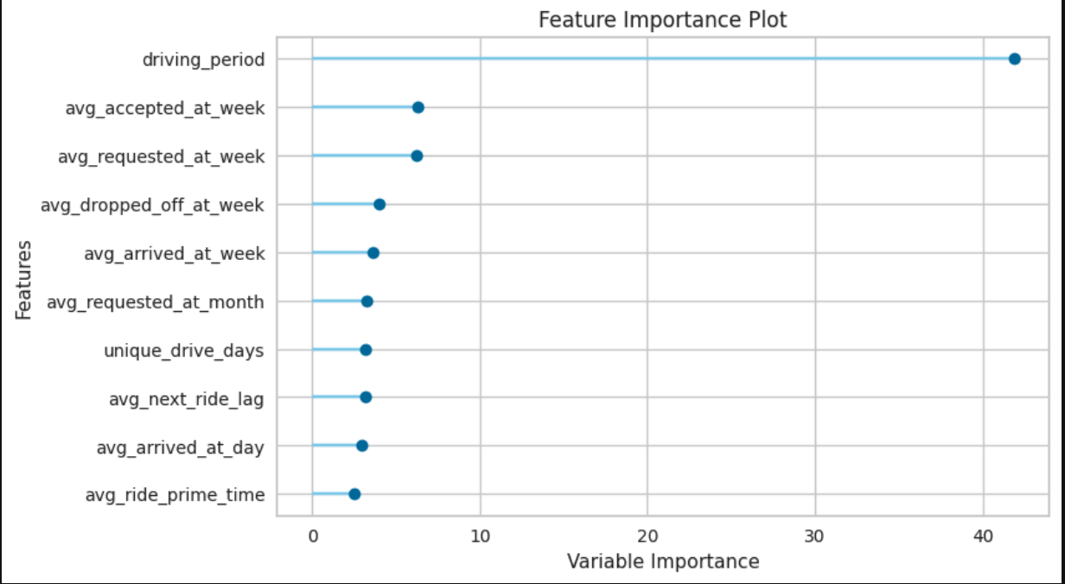
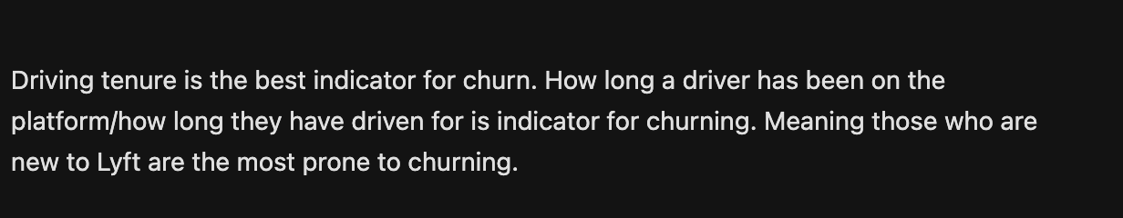
Churn
Notes:
% Active Drivers over time in weekly buckets cohorted by onboard week
Segmented driver population to identify driving behavior that may lead to churn.

Slide 9
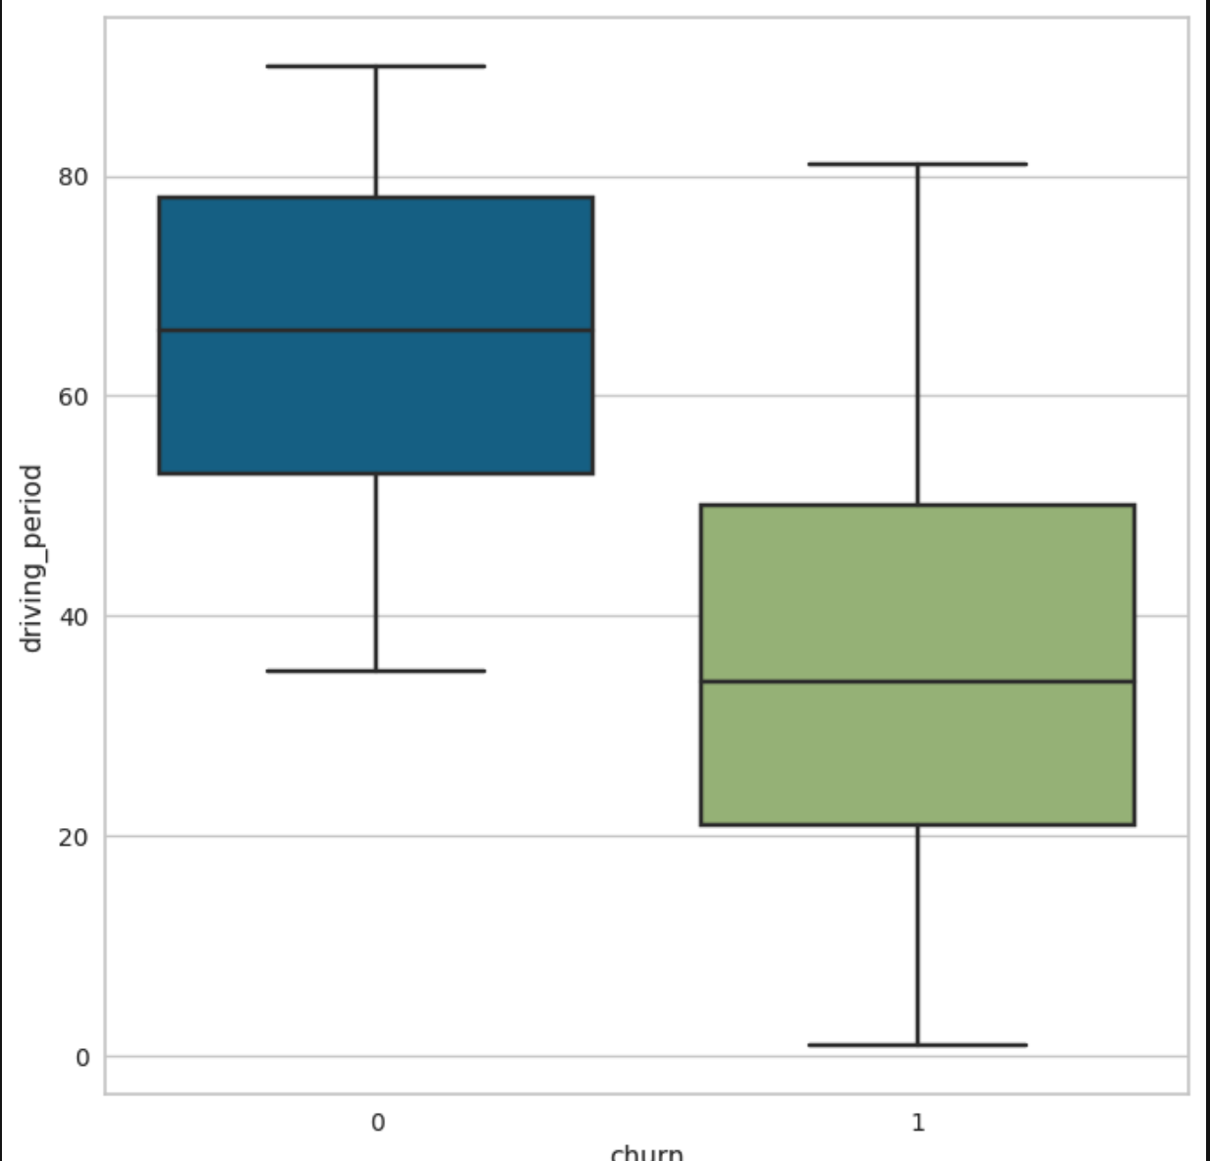
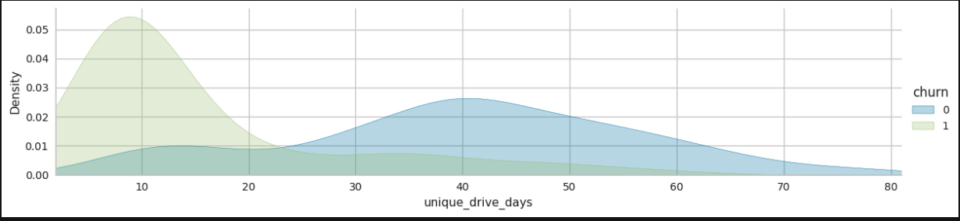
Factors Driving Churn
Clear difference between churn and non-churn when it comes to driving tenure and unique number of total driving days.

Slide 10
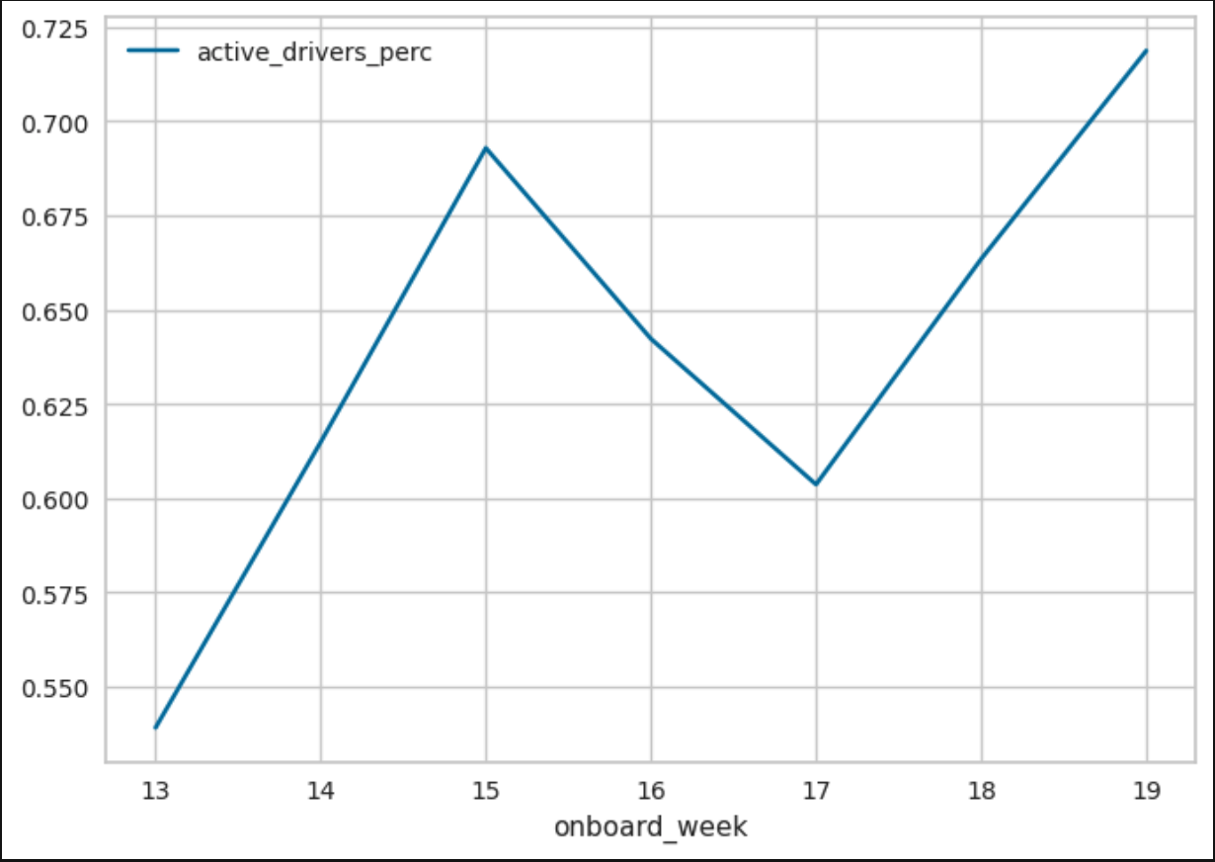
% Active Drivers By Onboard Week

Slide 11
Actionable Recommendations for Lyft
Considering that those contributing most to Lyft’s revenue and hopefully profitable are those who drive a lot during the days they drive, would be best to reward these customers. This would incentivize them/reinforce this strategy of maximizing time out on the road. Possibly free/discounted tickets to events they like would be a good move to increase LTV/retention.
In order to determine how to increase activity/engagement of churned drivers I would recommend a deeper dive into user journeys and see what behavior brought high LTV/power users from casual user to loyal Lyft driver. Further investigation needed to determine ‘ah-ha’ moment to safeguard against driver/supply drop-off.
Also, looking into factors contributing to onboard week #15 and #19 would help bring supply to a healthy level to ensure supply is met in marketplace.
Considering that a Lyft lifetime is approximately 2.5 years, at 2 year mark, providing some bonus in monetary or car maintenance reward would make driver feel recognized and supported and most likely carry-on as a Lyft driver.

Slide 12
Appendix
Analysis/Code: Attached .pynb file

